Slide 1


Real Estate Checklist Tracker
Team 1
CS673
Fall 2024
RealList
Unlock simplicity in your rental journey!

Slide 2
Our Team
Sergio
Khalil
Backend Developer,
Scrum Master
Yuhang Zhang
QA Engineer, Front End Developer
Asma Asiri
Figma Designer, Front End Developer
Brad Nissenbaum
Project Manager, Backend Developer, Industry Expert
Shivaang Kumar
Front-end Developer, QA Engineer

Slide 3

The Idea
Streamline communication between real estate agents and their clients
Help efficiently track the progress of rental applications - including submitting necessary documents and payments
Ensure transparency
Reduce manual paperwork during the leasing process

Slide 4
The Need
“Most of the communication was done in one long email chain (over 60 emails), which became hard to track.”
Apartment renter in Brookline
Our market research shows:
“A shared checklist of completed and incomplete requirements and “per-issue” communication would be handy.”
Apartment renter in Cambridge
“Being able to go through the application/approval/moving process all in one place vs various email and text threads would be helpful.”
Apartment renter in Fenway

Slide 5
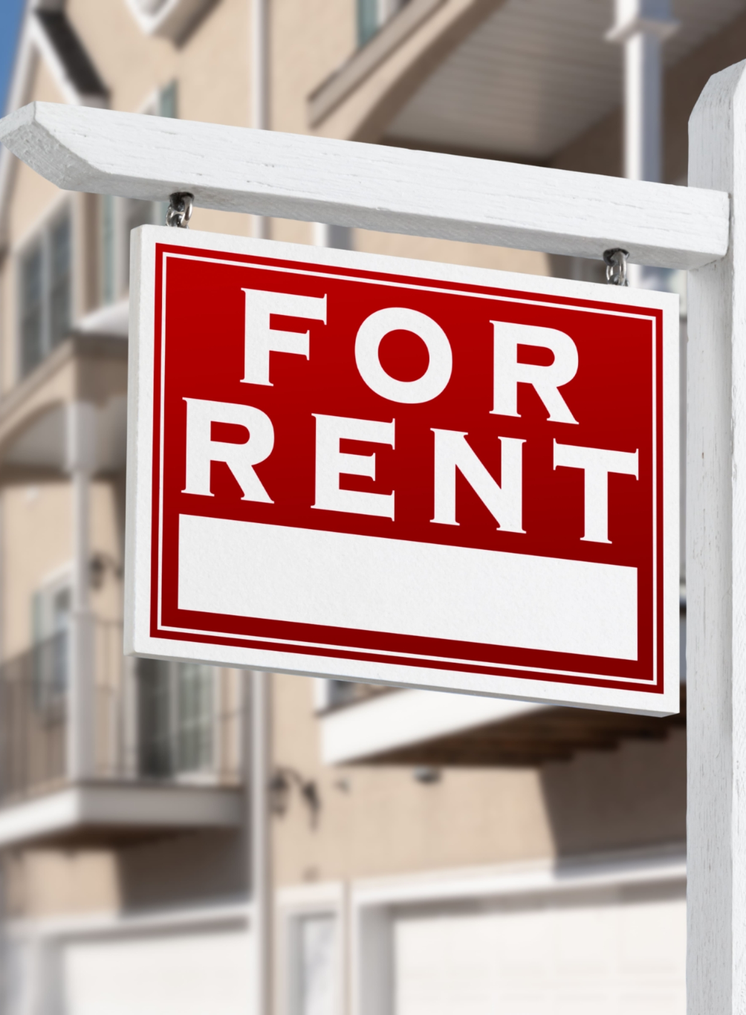
Scope
Application Management: Create, add/remove users, delete, show progress
Task Creation: Agents can customize tasks based on individual client needs.
Document Management: Agents and clients can upload, store, and manage documents in a centralized, secure, repository.
Status Dashboard: Agents and clients can view progress through a dashboard.

Slide 6

Goals
Improve communication: Reduce delays by centralizing messaging.
Track progress: Enable clients and agents to monitor progress easily.
Reduce paperwork: Transition from manual handling to digital workflows.
Ensure transparency: Build trust through real-time updates.
Notes:
The Real Estate Checklist Tracker project aims to create a system that improves communication and document tracking between agents, brokers, and clients during the leasing process. It enables agents to manage checklists, clients to track application progress, and both parties to handle documents efficiently, reducing delays and ensuring transparency​.

Slide 7

Target Users
Brokers/Managers: The owners/managers of the brokerage who manage the agents.
Real Estate Agents: Professionals who manage property rentals.
Clients: Individuals looking to rent real estate properties.

Slide 8
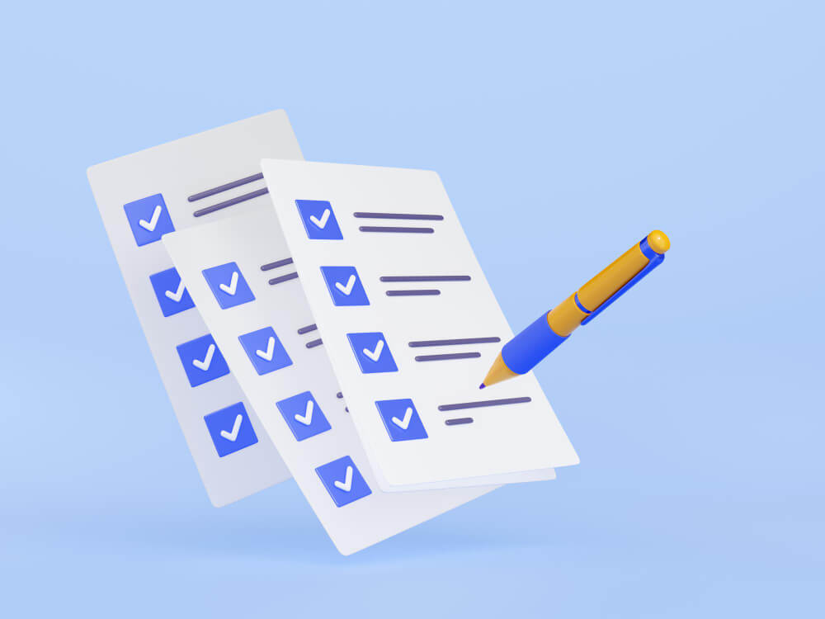
High Level Requirements
(Functional Requirements)
User Authentication and Roles.
Agent, Client
Checklist Creation and Management.
Document Upload and Management.
Email Notifications.
Dashboard for Monitoring Progress.
% complete and status bar
Search Capabilities
By address, client, or ID

Slide 9

High Level Requirements
(non-Functional Requirements)
Performance - Load page in less than 1 second, handle 100+ users
Security - Personally Identifiable Information private and secure
Usability - Easy, intuitive interface
Reliability and Availability - Hosted in AWS
Maintainability and Support - Follow coding best practices

Slide 10
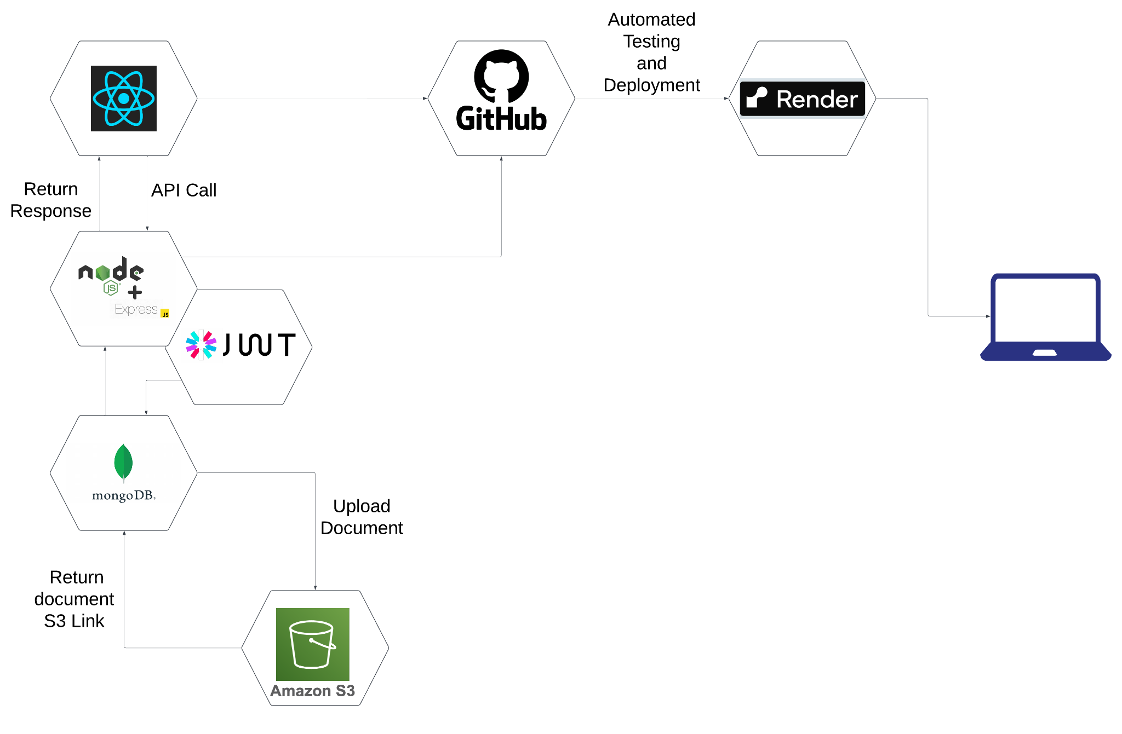
Tools Connectivity

Slide 11
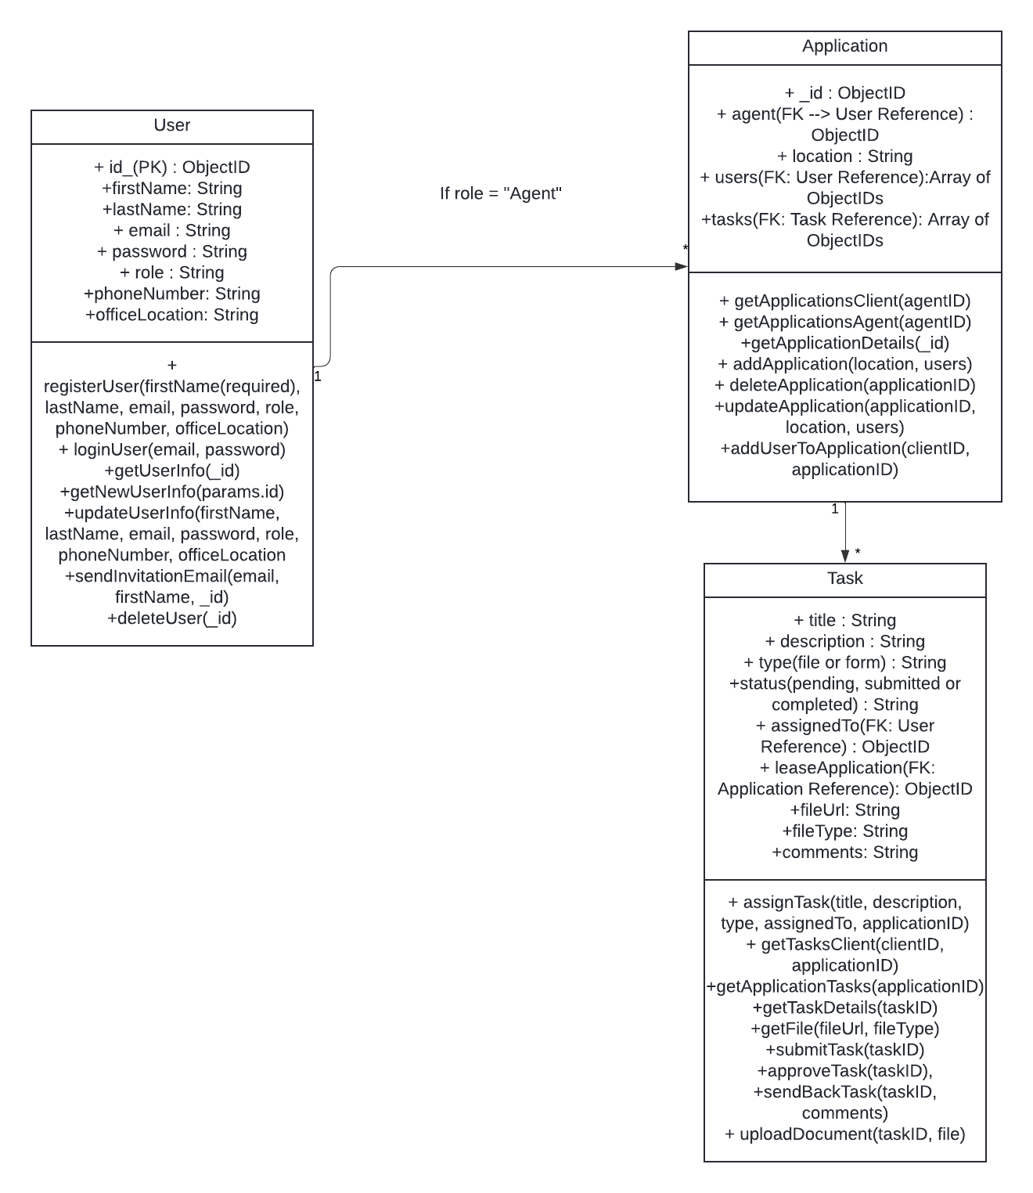
UML Diagram

Slide 12
Demo

Slide 13
Final Thoughts
Problems encountered:
Competing deadlines with other classes/work.
Security and token issues
Fixing bugs takes longer than expected.
Lessons Learned:
Clearly defining the scope and requirements upfront helps avoid scope change.
Proper time management and realistic deadlines are critical for smooth project execution

Slide 14
Conclusion; Q&A
Next Steps:
Deploy the application live
Use the application for actual apartment applications
Email Notification - Assigned task to client, Status update (Client and Agent)
Discuss monetization strategy
Open to Feedback:
We appreciate any feedback on our progress and suggestions to help us refine our approach as we move into the next development phase.

